Slide 1
ATOMISTIC MOLECULAR DYNAMICS STUDY OF LINEAR AND BRANCHED IMIDAZOLE-FUNCTIONALIZED POLYMERS
Twaha Alim, Sujith Ganta, Axel Mellinger, Ph.D, Anja Mueller, Ph.D, Leela Rakesh, Ph.D*, Tallia Sebastian, Ph,D.
*Contact e-mail→rakes1l@cmich.edu
DISTRIBUTION STATEMENT A.
Approved for public release; distribution is unlimited. OPSEC #10934

Slide 2
Atomistic MD Simulation of Linear and Branched- Imidazole Polymers
Understanding Polymer Architecture to Design Next-Generation High-Temperature Hydrogen Fuel Cell Membranes
DISTRIBUTION STATEMENT A.
Approved for public release; distribution is unlimited. OPSEC #10934

Slide 3
Presentation Roadmap
Today's presentation follows six key steps:
The Problem→ Why current proton exchange membranes limit fuel cell performance
Motivation→ Why understanding polymer architecture is important
Research Questions→ What molecular properties are we trying to understand?
Molecular Dynamics Simulations
  How computational modeling was used to investigate the polymers
Key Results
  Glass transition temperature (Tg)
  Molecular packing (RDF)
Chain conformation (Rg)
Engineering Impact
  How these findings guide the design of future high-temperature proton exchange membranes
Conclusions and Future Work
DISTRIBUTION STATEMENT A.
Approved for public release; distribution is unlimited. OPSEC #10934

Slide 4
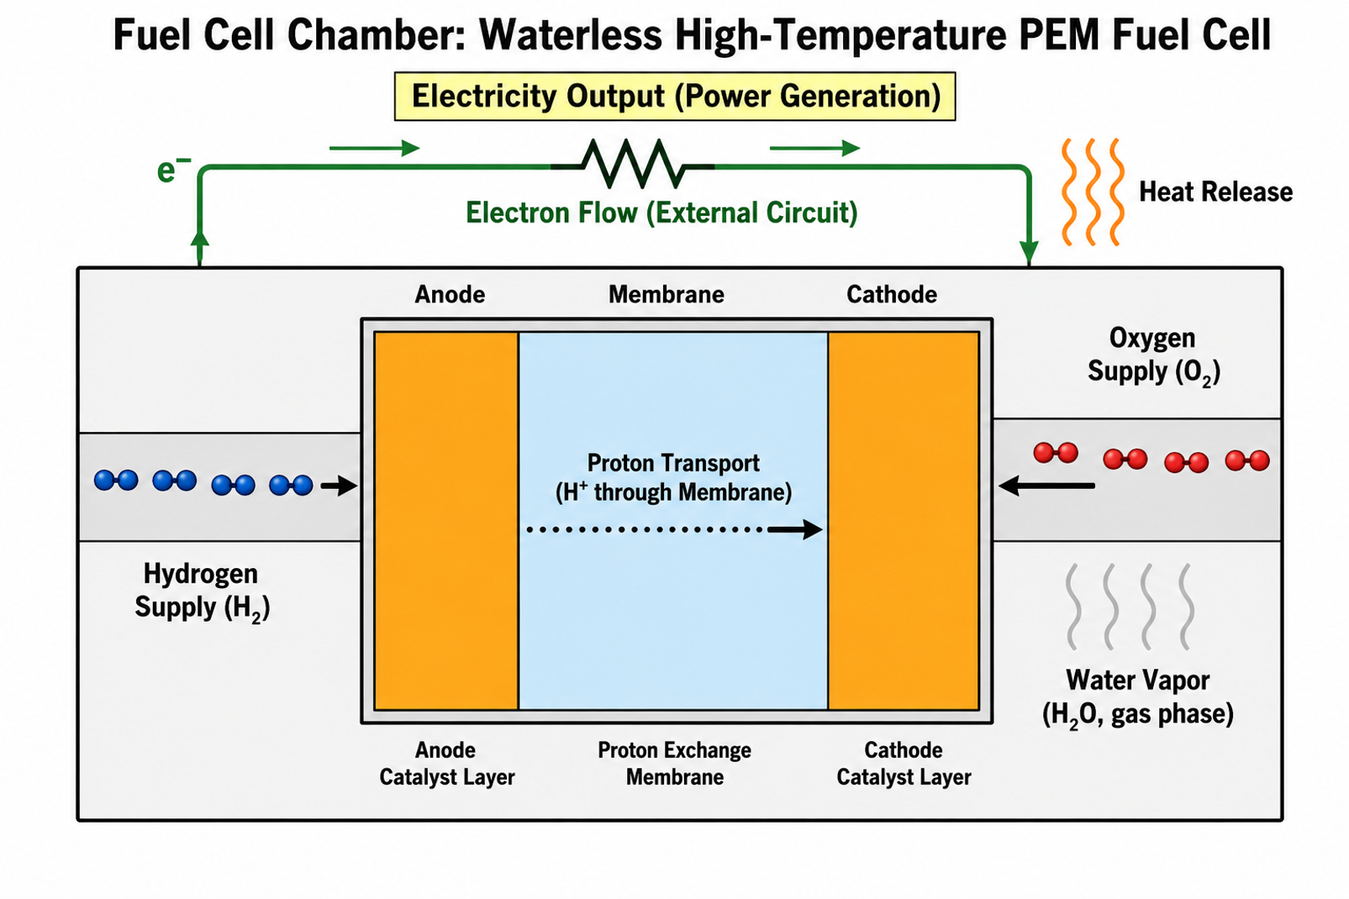
Motivation?
Hydrogen Fuel Cells Need Better Polymer Membranes
Hydrogen fuel cells produce electricity with water as the only by-product.
Membrane properties determine efficiency, durability, and operating temperature.
Designing better polymer electrolytes requires understanding molecular structure.
Key Message
Developing better proton exchange membranes is essential for more efficient, lighter, and more durable hydrogen fuel cell systems.
Figure 1:Schematic of a proton exchange membrane fuel cell highlighting the polymer electrolyte membrane controlling proton transport between electrodes
DISTRIBUTION STATEMENT A.
Approved for public release; distribution is unlimited. OPSEC #10934

Slide 5
Scientific Problem & Research Questions
Scientific Problem: How does polymer architecture influence the structure and dynamics of high-temperature proton exchange membranes (PEMs)?
Branching modifies chain flexibility and free volume.
Imidazole functionalization introduces proton-conducting sites and new intermolecular interactions.
The combined influence of these structural modifications on membrane behavior remains poorly understood.
Research Questions:
How do branching and imidazole functionalization affect the glass transition temperature (Tg)?
How do they influence molecular packing and local structure? (Radial Distribution Function- RDF)
How do they alter polymer chain conformation and molecular mobility? (Radius of Gyration- Rg)
Effect of Molecular Mobility (MSD)
What are the implications for proton transport in dry high-temperature polymer electrolytes?
Key Message
Understanding the relationship between polymer architecture, molecular dynamics, and structure is essential for designing high-performance proton-conducting membranes.
DISTRIBUTION STATEMENT A.
Approved for public release; distribution is unlimited. OPSEC #10934

Slide 6
Why This Research Matters
Using Molecular Simulations to Accelerate Membrane Design
Engineering Motivation
Traditional experimental development requires significant time and cost because each new polymer must be synthesized and tested individually.
Molecular dynamics simulations allow us to:
Predict polymer behavior before synthesis.
Evaluate the effect of branching and functionalization independently.
Understand molecular mobility, packing, and structural organization.
Identify promising membrane architectures before experimental validation.
Benefits for Fuel Cell Development
Faster material discovery
Reduced experimental cost
Improved membrane durability
Better high-temperature performance
Guidance for future polymer synthesis
Key Message
Simulation guides experiments by identifying the most promising polymer designs.
DISTRIBUTION STATEMENT A.
Approved for public release; distribution is unlimited. OPSEC #10934
Notes:
Note: Take-Home Message→ Simulation guides experiments by identifying the most promising polymer designs.

Slide 7
Polymer Design Strategy for High-Temperature Proton Exchange Membranes
Molecular Architecture Control for Enhanced Proton Transport Design Challenges
High-temp. (150-180 °C), anhydrous proton transport requires new polymer architectures beyond conventional hydrated PEMs.
Polymer structure must balance: Proton-conducting functionality; Chain mobility; Thermal stability; Phase-separated morphology
Polymer Design Approach
Develop fluorinated aromatic polymer backbones for high thermal and chemical stability.
Introduce proton-conducting groups (e.g., sulfone group/imidazole-based functionalities).
Tune: Backbone rigidity and flexibility; functional group density, polymer architecture and morphology
Goal:
Create polymer architectures that promote continuous proton transport pathways while maintaining mechanical and thermal stability.
DISTRIBUTION STATEMENT A.
Approved for public release; distribution is unlimited. OPSEC #10934

Slide 8
Computational Modeling and Simulation – Guided Polymer Design
Predicting Polymer Structure, Dynamics, and Performance Before Synthesis
Computational Modeling Approach:
Molecular Simulation Platform: Software: BIOVIA Materials Studio
Force Field: COMPASS
Simulation Conditions: Temperature: 300-500 K; NPT Ensemble
Simulation Workflow: Polymer Model Construction→ Energy Minimization→ Equilibration→ Production Molecular Dynamics Simulation→ Trajectory Analysis
Predicted Polymer Properties:
Glass transition temperature (Tg)
Chain mobility and diffusion behavior (MSD)
Molecular interactions (RDF)
Chain conformation (Rg)
Structural organization and phase behavior
DISTRIBUTION STATEMENT A.
Approved for public release; distribution is unlimited. OPSEC #10934

Slide 9
From Simulation Predictions to Material Validation
Accelerating Polymer Discovery Through Modeling and Experiments
Simulation-Guided Screening
Compare polymer architectures before synthesis
Identify promising structures with optimal chain mobility, stable morphology
  Efficient proton transport pathways
Experimental Validation
Thermal properties: DSC and DMA
Morphology and phase structure: X-ray scattering, neutron scattering, SAXS/light scattering.
Material performance: polymer synthesis, proton conductivity and fuel cell testing
Key Message
Computational modeling narrows the polymer design space and guides experimental efforts toward high-performance high-temperature PEM materials.
DISTRIBUTION STATEMENT A.
Approved for public release; distribution is unlimited. OPSEC #10934

Slide 10
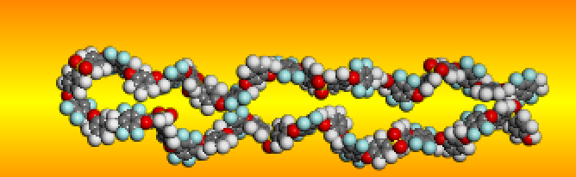
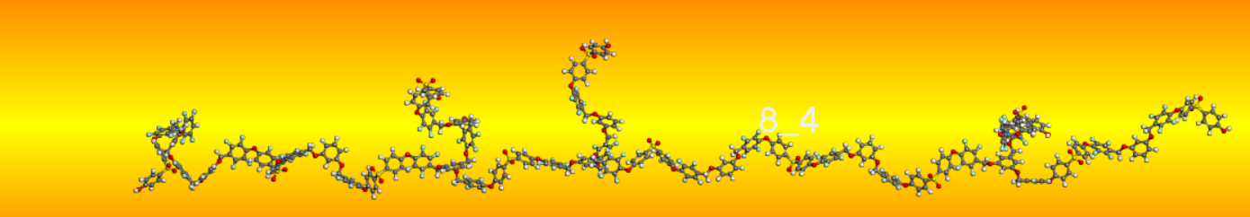
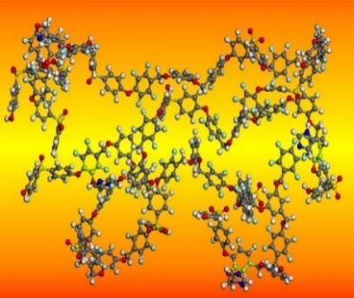
Polymer Systems Investigated
Three Polymer Architectures with Increasing Structural Complexity
8L→ Linear polymer
8L4B→ Linear polymer with four branches
8L4B-4Iz→ Branched polymer functionalized with imidazole groups
Figure 2a: Molecular structure of the
unoptimized 8L polymer.
Figure 2b: Molecular structure of the unoptimized 8L4B polymer
Key Message
Only the architecture changes, allowing direct comparison of structure-property relationships
Figure 2c: Optimized structure of the 8L4B-4Iz polymer.
DISTRIBUTION STATEMENT A.
Approved for public release; distribution is unlimited. OPSEC #10934

Slide 11
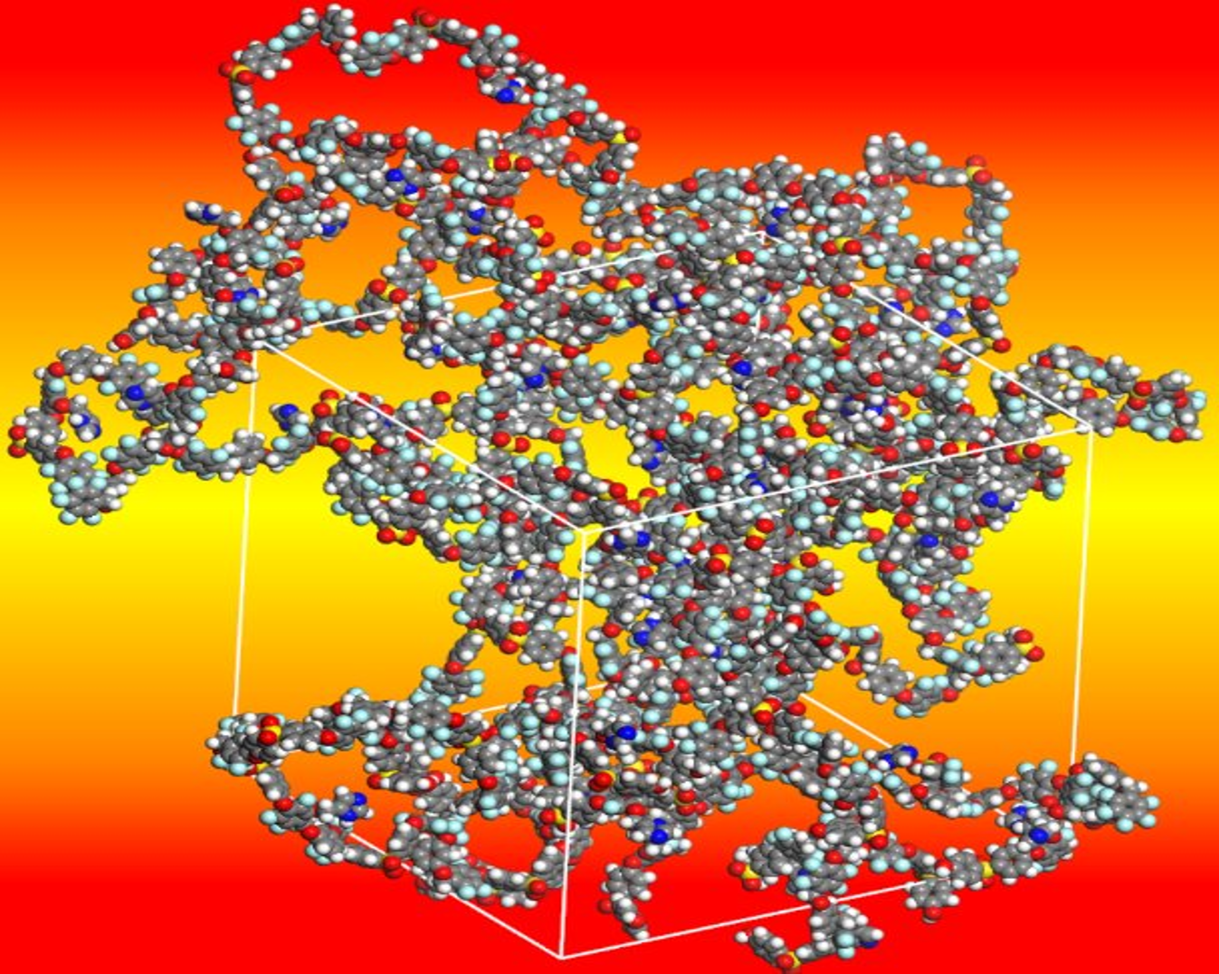
Results – Glass Transition Temperature (Tg)
When Does the Polymer Become Mobile?
At low temperature
Rigid, glassy polymer
At high temperature
Flexible polymer chains
Tg from Mean Square Displacement (MSD)
Mean squared displacement measures atomic motion.
Relaxation time identifies the glass transition more reliably than volume measurements (Karakaus et al., 2026)
The diffusion coefficient is extracted from the slope of MSD at long times
Plotting relaxation time against inverse temperature reveals a sharp change in slope at Tg
Figure 3: Optimized structure of the 8L4B-4Iz polymer (amorphous cell) following energy minimization.
DISTRIBUTION STATEMENT A.
Approved for public release; distribution is unlimited. OPSEC #10934
Karakus, K.; Ginzburg, V. V.; Promislow, K.; Rakesh, L. J. Non-Cryst. Solids, 2026, 672, 123800

Slide 12
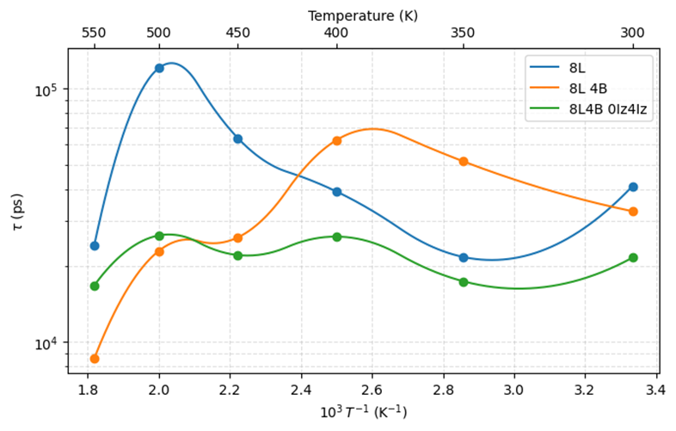
Polymer Architecture Controls Tg
Effect of Branching and Functionalization on Tg
8L (linear polymer)
Highest Tg (~500 K).
Rigid backbone and efficient chain packing restrict segmental motion.
8L4B (branched polymer)
Lower Tg (~400-450 K).
Branching disrupts packing and increases chain conformational freedom.
8L4B-4Iz (branched and imidazole-functionalized)
Further reduced Tg (~400 K).
Imidazole functionalization increases local flexibility and weakens packing interactions
Figure 4: Temperature dependence of structural relaxation time (τ = 1/D) vs. 1/T for 8L, 8L4B and 8L4B-4Iz showing a shift in dynamic transition (Tg-like behavior) with different polymer architecture.
Key Message
Polymer architecture regulates Tg by controlling chain packing and molecular flexibility.
DISTRIBUTION STATEMENT A.
Approved for public release; distribution is unlimited. OPSEC #10934

Slide 13
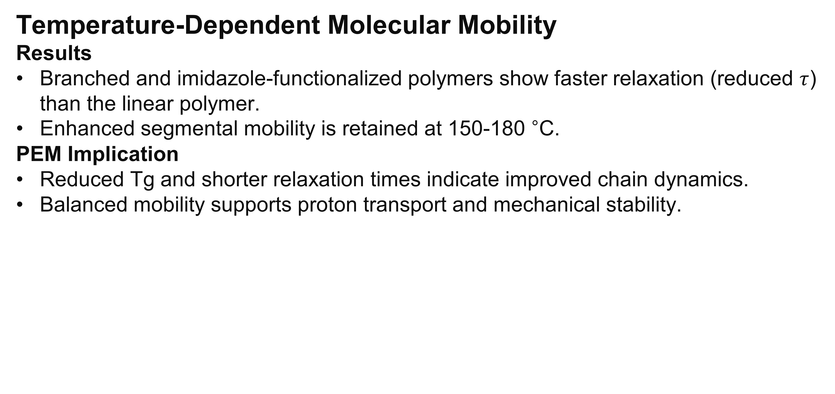
Architecture-Dependent Segmental Relaxation Dynamics
Temperature-Dependent Molecular Mobility
Results
Branched and imidazole-functionalized polymers show faster relaxation (reduced $τ$) than the linear polymer.
Enhanced segmental mobility is retained at 150-180 °C.
PEM Implication
Reduced Tg and shorter relaxation times indicate improved chain dynamics.
Balanced mobility supports proton transport and mechanical stability.
Key Message
Architectural modification shifts polymer dynamics toward the mobility window required for dry, high-temperature proton conduction.
DISTRIBUTION STATEMENT A.
Approved for public release; distribution is unlimited. OPSEC #10934

Slide 14
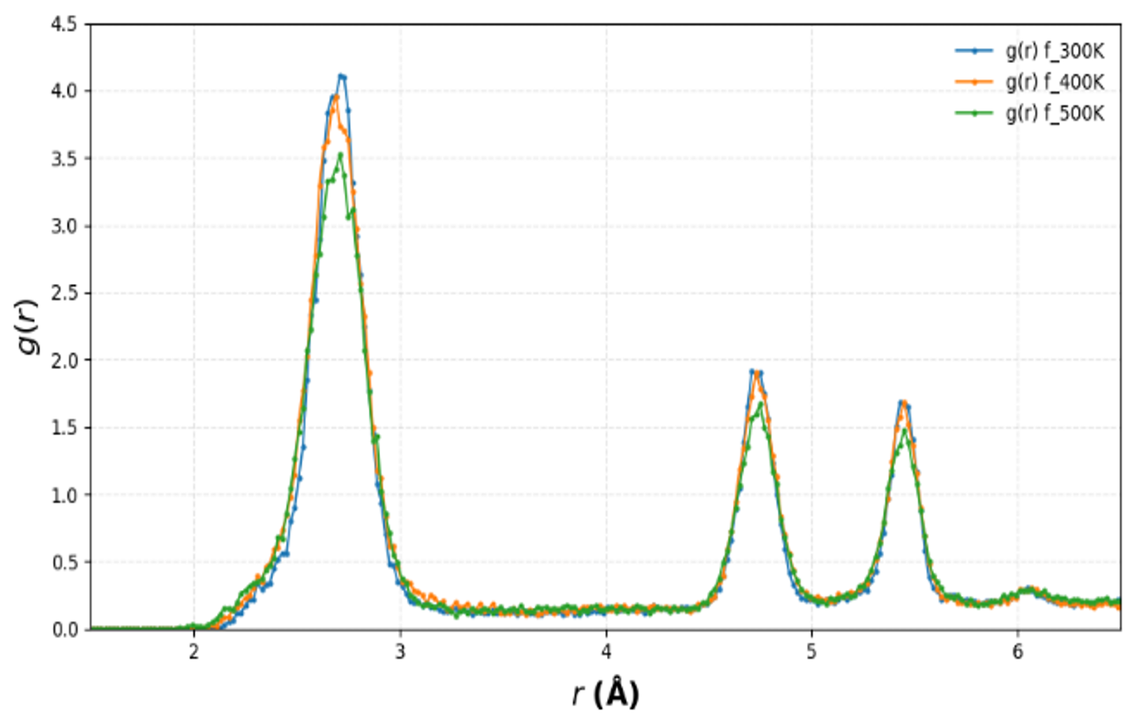
Temperature-Dependent Local Packing: F-F Radial Distribution Function (RDF)
RDF→ measures the probability of finding atom pairs at distance r relative to a random distribution, indicating local packing, coordination, and short-range ordering.
RDF Interpretation:
Sharp, high peak: Strong local ordering and rigid packing.
Broad, weak peak: Reduced ordering, increased flexibility, and thermal disorder.
Results:
First F-F peak (~2.7 Å) represents nearest-neighbor fluorine correlations.
Peak intensity decreases from 300 → 400 → 500 K, indicating weaker local packing.
Higher-order peaks also weaken, showing
increased segmental motion at elevated temp.
Figure 5: FF radial distribution functions (g(r)) of 8L4B-4Iz at 300-500 K showing temperature-dependent changes in local packing, ordering, and segmental flexibility. (Peak height and width reflect variations in local ordering and the distribution of interatomic distances.)
Key Message
Heating promotes local relaxation and chain mobility while maintaining the polymer framework supporting proton transport.
DISTRIBUTION STATEMENT A.
Approved for public release; distribution is unlimited. OPSEC #10934

Slide 15
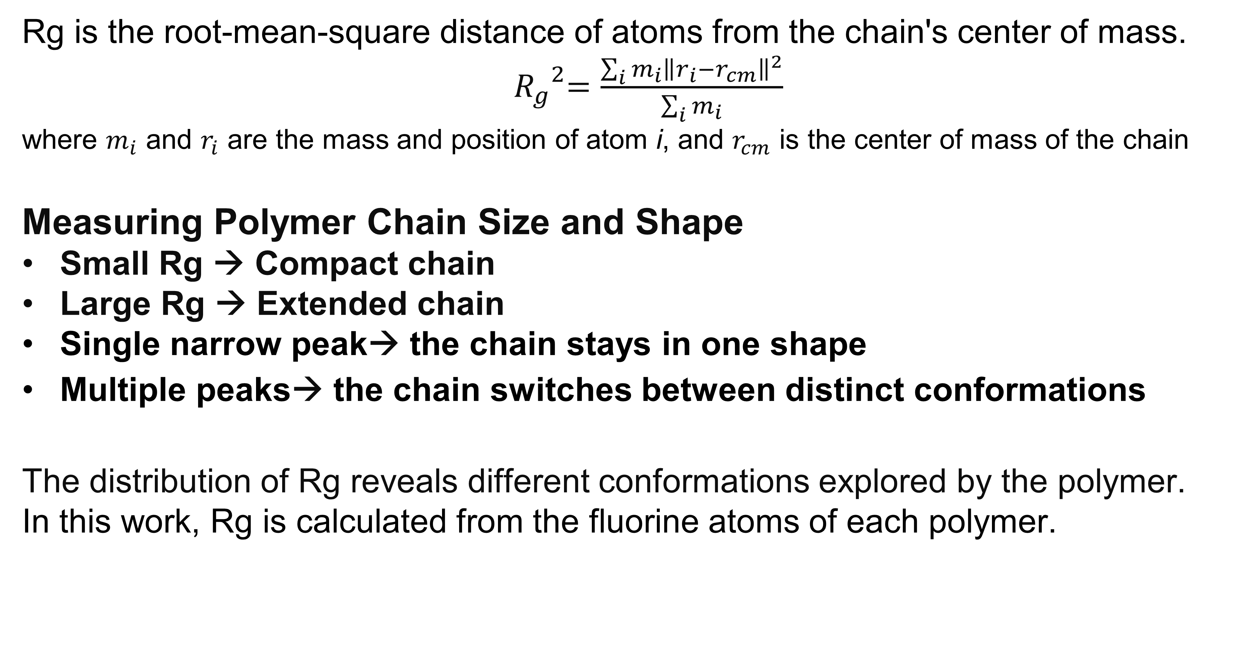
What is Radius of Gyration (Rg)?
Rg is the root-mean-square distance of atoms from the chain's center of mass.
${ R_{g}}^{2}=\frac{\sum_{i}{m_{i}{\left\|r_{i}−r_{cm}\right\|}^{2}}}{\sum_{i}{m_{i}}}$
where $m_{i}$ and $r_{i}$ are the mass and position of atom i, and $r_{cm}$ is the center of mass of the chain
Measuring Polymer Chain Size and Shape
Small Rg → Compact chain
Large Rg → Extended chain
Single narrow peak→ the chain stays in one shape
Multiple peaks→ the chain switches between distinct conformations
The distribution of Rg reveals different conformations explored by the polymer.
In this work, Rg is calculated from the fluorine atoms of each polymer.
DISTRIBUTION STATEMENT A.
Approved for public release; distribution is unlimited. OPSEC #10934

Slide 16
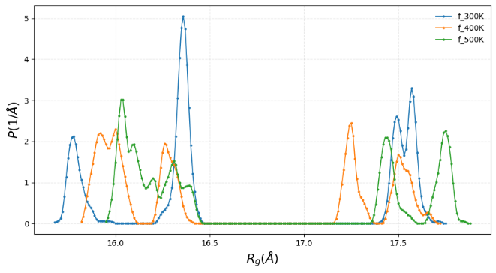
Architecture-Dependent Polymer Chain Dimensions (Rg)
8 Repeat Unit Polymers (300-500 K)
Architecture Effect
8L (linear): compact structure (Rg ~11.6-13.4 Å)
8L_4B (branched): expanded architecture (Rg ~16.2-18.3 Å) due to branch-induced chain extension
8L_4B-4Iz: maintains branched dimensions (Rg ~15.5-18.0 Å); imidazole mainly affects local interactions
Temperature Effect
Rg remains nearly constant from 300-500 K.
Heating increases chain flexibility without
disrupting the polymer framework.
Fig 6: Temperature Dependent F-F Rg distributions of the 8L_4B-4Iz polymer at 300-500 K, showing preserved global chain dimensions with increasing thermal flexibility.
Key Message
Branching controls global chain dimensions, while imidazole functionalization tunes local packing and segmental dynamics.
DISTRIBUTION STATEMENT A.
Approved for public release; distribution is unlimited. OPSEC #10934

Slide 17
Polymer Architecture-Dependent Proton Transport Potential
Polymer | Key Characteristics | Transport Potential
8L | Compact structure; lower chain expansion | Lower free volume and limited transport pathways
8L_4B | Extended branched architecture; improved chain dynamics | Enhanced mobility and structural stability
8L_4B-4Iz | Branched structure with imidazole proton-conducting groups | Best balance of mobility, interactions, and transport pathways
Key Message
Branching expands the polymer framework, while imidazole functionalization enhances proton-transport functionality, making 8L_4B-4Iz the most promising dry high-temperature PEM candidate.
DISTRIBUTION STATEMENT A.
Approved for public release; distribution is unlimited. OPSEC #10934

Slide 18
Structure-Dynamics Relationship and Proton Transport Implications
Polymer architecture controls chain conformation, packing, and molecular organization.
Elevated temperature increases segmental motion and conformational flexibility while maintaining the polymer framework.
Changes in chain dynamics and morphology influence proton-coordination environments and potential transport pathways.
MD provides a structural basis for designing and understanding dry, high-temperature proton-conducting polymers.
Future Validation and Design Directions
Hydrogen-bonding analysis
Reactive MD (ReaxFF) for proton-transfer mechanisms
Experimental validation (EIS, conductivity, morphology)
DISTRIBUTION STATEMENT A.
Approved for public release; distribution is unlimited. OPSEC #10934

Slide 19
Engineering Significance: Architecture as a Design Strategy for High-Performance PEMs
Molecular design enables:
Reduced dependence on humidification
Simplified balance-of-plant requirements
Lower system weight and complexity
Improved fuel-cell efficiency and durability
Faster discovery of next-generation membrane materials
Key Message
Strategic control of polymer architecture through branching and imidazole functionalization enables tuning of Tg, chain dynamics, and proton-transport environments, providing a pathway toward high-performance dry, high-temperature PEMs.
DISTRIBUTION STATEMENT A.
Approved for public release; distribution is unlimited. OPSEC #10934

Slide 20
Conclusions & Final Message
Final Conclusion
Molecular dynamics reveals key structure-property relationships in dry polymer electrolytes.
Architecture dominates polymer organization and dynamics more strongly than temperature.
8L_4B-4Iz provides the optimal balance of stability, mobility, and proton-transport potential.
Final Message
Molecular-level polymer design provides a predictive route toward next-generation high-temperature, low-humidity hydrogen fuel-cell membranes.
DISTRIBUTION STATEMENT A.
Approved for public release; distribution is unlimited. OPSEC #10934

Slide 21
Future Work
Experimental Synthesis and validation (yet to be completed)
Larger Repeat unit & Longer Simulation time
Proton Conductivity Measurements
Proton Hopping Mechanisms
Mechanical Characterization
Fuel Cell Performance Testing
DISTRIBUTION STATEMENT A.
Approved for public release; distribution is unlimited. OPSEC #10934

Slide 22
Acknowledgments
Funding: US Army: Automotive Research Center (ARC) in accordance with Cooperative Agreement W56HZV-24-2-0001 U.S. Army DEVCOM Ground Vehicle Systems Center (GVSC), Warren, MI
Research Advisor: Prof. Leela Rakesh
Collaborators → Prof. Anja Mueller, Prof. Axel Mellinger, Dr. Talia Sebastian, Dr. Ted Burye
Research Group: Sujith Ganta, Nazmul Hasan, Phoenix Knipe, Sithira Samaranayake, Gavin Mehl, Milah Curry
Institutional Support: Central Michigan University, The Graduate School, Department of Mathematics (Applied Mathematics & Polymer Fluid Dynamics and Computational Research Group), School of Engineering and Technology, Department of Chemistry and Biochemistry, and Department of Physics
DISTRIBUTION STATEMENT A.
Approved for public release; distribution is unlimited. OPSEC #10934

Slide 23


Thank You For Your Kind Attention!
Questions?
For further information, please contact:
rakes1l@cmich.edu
Prof. Leela Rakesh (Computational Advisor )
Department of Mathematics- Applied Mathematics and Multiscale Polymer Dynamics Group
"Developing predictive models of complex fluids and advanced polymer materials through experiments, molecular dynamics, coarse-grained simulations, and continuum-scale modeling”
Central Michigan University, Mt. Pleasant, Michigan 48859
Email: rakes1L@cmich.edu
Central Michigan Chippewas
DISTRIBUTION STATEMENT A.
Approved for public release; distribution is unlimited. OPSEC #10934

Slide 24
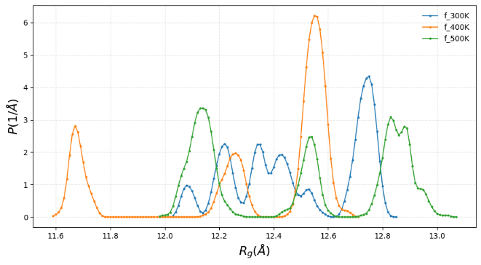
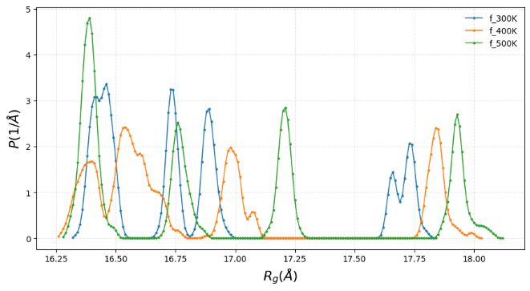
Figure 7: Radius of gyration of fluorine atoms in 8L at 300K, 400K, 500K.
Figure 8: Radius of gyration of fluorine atoms in 8L4B at 300K, 400K, 500K.
DISTRIBUTION STATEMENT A.
Approved for public release; distribution is unlimited. OPSEC #10934

Slide 25
